Slide 1

FHIR Powered Healthcare
Notes:
This deck is a template for What The Hack lectures.
It is recommended that Coaches deliver mini-lectures ahead of each Challenge that set context for the challenge and introduce & explain any key technologies.
At a minimum, it is handy to have a slide with the key goals of each challenge to display on the screen when running the hack in-person.

Slide 2

FHIR Powered Heathcare
Welcome & Intros
<Coach Name>
<Coach Name>
<Coach Title>
<Coach Title>
<Coach Name>
<Coach Name>
<Coach Title>
<Coach Title>
Notes:
Coaches/Presenters for THIS hack/lecture event should be listed on this slide.
Original contributors to the hack content & these slides include:
Please list original contributors to this hack here in the speaker notes and give them credit when delivering this content.
<Original Author 1>
<Original Author 2>
…
<Original Author N>

Slide 3

Objective What to Expect:
What to Expect:
Hands-on experience Azure Health Data Services platform in Microsoft Health Architectures, including:
Extract and load FHIR synthetic Electronic Health Record (EHR) data
Extract, transform and load HL7v2 messages
Extract, transform and load synthetic C-CDA EHR data
Connect to FHIR Server and search FHIR data through a Patient Search Web App
Explore and analyze FHIR EHR data for secondary analytics use
Bulk export, anonymize and store FHIR data into Data Lake for secondary use
Ingest and persist IoT medical device data using MedTech service
Load DICOM imaging data using DICOM service
Intended Outcomes:
WTH participants will walk away with:
Ability to deploy and interact with Microsoft Health reference architectures (above) for health data interoperability use cases
Notes:
Template for a lecture slide with bullets (if you need them).
Try to NOT use bullet lists in your presentation.
Diagrams, puppy pictures, etc are always better. ☺

Slide 4






Modern Healthcare Solutions Face New Challenges
TRADITIONAL HEALTH DATA SYSTEMS
Interoperability
Security
Compliance
EVOLVING DATA SYSTEMS
Notes:
Organizations building healthcare solutions face significant challenges as the data needed for modern solutions leveraging advanced analytics and machine learning can be difficult to access and is often segregated into different silos based on a variety of healthcare systems including electronic health records (EHR), financial/billing systems, customer relationship management (CRM) for marketing, picture archiving and communication systems (PACS) for imagery and more. To further complicate matters, evolving health data systems, including connected devices in the Internet of Medical Things (IoMT), genomics and immunomics systems, big data sets from government agencies and research institutions and more, make it difficult to get a complete view of a patient’s or population’s data. The desire is to bring all this data together to build modern healthcare solutions that can improve clinical, financial, operational, and population health analytics. The ability to digitally capture, annotate, and combine data to apply machine learning will transform the delivery of healthcare.
In order to successfully bring together the relevant data and apply machine learning, organizations require a platform that supports standards-based interoperability, the security and privacy needed when working with PHI, and the compute capability to process a large amount of data.

Slide 5

Enabling Interoperability of Health Data
INTEROPERABILITY
RESEARCH
STARTUP
Create new healthcare systems of engagement by connecting data from multiple systems of record.
Enable new research opportunities through normalized clinical data.
Focus on the innovations you are investing in instead of the data platform.
Notes:
According to the paper published in JMIR Medical Informatics “despite the relatively rapid nationwide adoption of electronic health records (EHRs), the industry’s ability to successfully exchange computable health data has not kept pace. A recent study found that less than 35% of providers report data exchange with other providers within the same organization or affiliated hospitals. The exchange of data across organizations is even more limited, with less than 14% of providers reporting they exchange data with providers in other organizations or unaffiliated hospitals.” These systems have been developed using older standards, including HL7® v2.x, Clinical Document Architecture (CDA) and proprietary APIs that make it challenging for healthcare solution developers to leverage these systems across healthcare providers. This has significantly limited access to healthcare data across providers and made it far too difficult to gain insight that can be derived from analytics and machine learning.
Azure API for FHIR® implements the HL7® FHIR® specification, enabling interoperability based on an emerging industry standard data model and RESTful interface for health data. The cloud-based API supports SMART on FHIR® integration with Azure Active Directory to enable 3rd party application developers to leverage existing application development.
The Azure API for FHIR® was designed around three primary use cases – health system interoperability, research, and startup/innovation health projects. Across these use cases is a similar pattern – data from one or more systems of record coming together in a single persistence model through the Azure API for FHIR® and being enriched through analytics and machine learning. New systems of engagement interact with the data through the Azure API for FHIR®.
Health System Interoperability
While EHRs exist as the primary ‘source of truth’ in many clinical settings, it is not uncommon for providers to have multiple instances of the same EHR offerings (10 variations of Epic installations), different EHRs in different parts of their ecosystem (5 Cerner EHR installations and 2 Epic installations) or to have several non-EHR databases that serve as a source of truth (e.g. PACs systems, research databases, IOMT databases, etc.). A typical provider ecosystem can house 20 (or more) databases that often don’t talk to one another or store data in different formats.
Standardizing on FHIR provides a more open and stable data structure and use of the Azure API for FHIR as a service that sits on top of those systems helps to enable interoperability and data exchange.
As institutions begin to implement various ML application to datasets, the Azure API for FHIR provides easy data exchange and means to annotate patient data thru FHIR APIs.
Research
Healthcare researchers will find the FHIR standard in general and the Azure API for FHIR useful as it normalizes data around a common FHIR data model and reduces the workload for machine learning and data sharing.
Exchange of data via the Azure API for FHIR provides audit logs and access controls which help control the flow of data and who has access to what data types.
Startup & Innovation Projects
Customers developing a patient or provider centric app (mobile or web) can leverage Azure API for FHIR as a fully managed backend service. The Azure API for FHIR provides a valuable resource in that customers can managing data and exchanging data in a secure cloud environment designed for health data, leverage SMART on FHIR implementation guidelines, and enable their technology to be utilized by all provider systems (e.g. most EHRs have enabled FHIR read APIs).

Slide 6









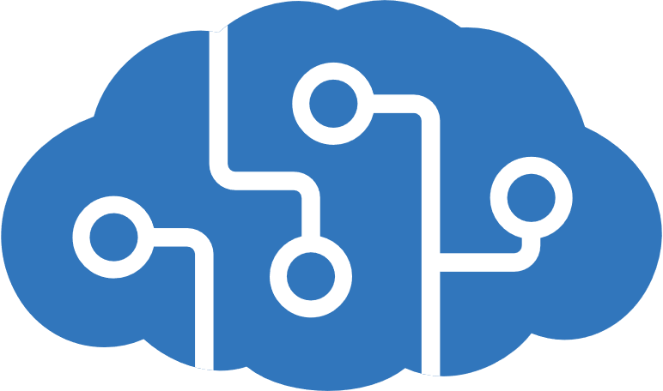


Enabling Healthcare Solutions in Azure
EHR
Imaging
-omics
Ingest & Enrich
Easily ingest and enrich any volume, variety or velocity of Healthcare data.
Persist
Create unified longitudinal records and track lineage.
Query & Provision
Provision and manage access for querying, exploration, operationalization.
Intelligence
Create new insights and build targeted AI models on the entire data estate.
3rd Party Data
IoMT
Scale
Easily leverage cloud for storage or processing of a variety of modalities at scale and lower costs.
Billing / Finance
CRM
Trust
Secure, compliant and operational.
Notes:
Who do these orgs need and want?
Initiatives: Interoperability, research, innovation
Moved to new standards defined by FHIR
Enable new tech to speak to your language 5000 feet view of what orgs are looking for
All system are generating data about patient and activities of particular org
Diff to connect and operate with one another
Put everything in one place for single view
Intelligences
Ingest systems into a single place (not replace legacy system)
Perform advanced analytics on data (AI/ML)
Scalability
Azure API for FHIR:
What we built to support what customer want
Support what customer want to do thru the above workflow:
Ingest & Enrichment of data: Easily ingest and enrich any volume, variety or velocity of Healthcare data
- ADF – pull data out of HLC systems
- IoMT – capture real-time remote data from connected devices
Azure Functions – incorporate into some workflow
Push – system can talk directly to Azure API for FHIR
Send FHIR data directly into Azure FHIR APIs
Any system can integrate with FHIR API can integrate with Azure API for FHIR (no proprietary changes)
Persist data: Create unified longitudinal records and track lineage
API for FHIR is where data is persisted
Customer sees the API endpoint and all security around it(not underlying infra)
Implementation details are hidden behind the scenes
Interact with those endpoints to scale up/down for throughput
Query & Provision data (into tools that are relevant): Provision and manage access for querying, exploration, operationalization.
Export FHIR data into Azure Databricks to reshape the data
Analytics and ML, need data in tabular structure and pull together diff parts of the data
Intelligence: Create new insights and build targeted AI models on the entire data estate
Once data is provisioned, you can bring it into difference intelligence systems and connect that out
Azure Synapse Analytics
Machine Learning, etc.
Scale
Easily leverage cloud for storage or processing of a variety of modalities at scale and lower cost.
Trust
Secure, compliant and operational.
Working outwards towards the edges:
IoMT FHIR Connector

Slide 7
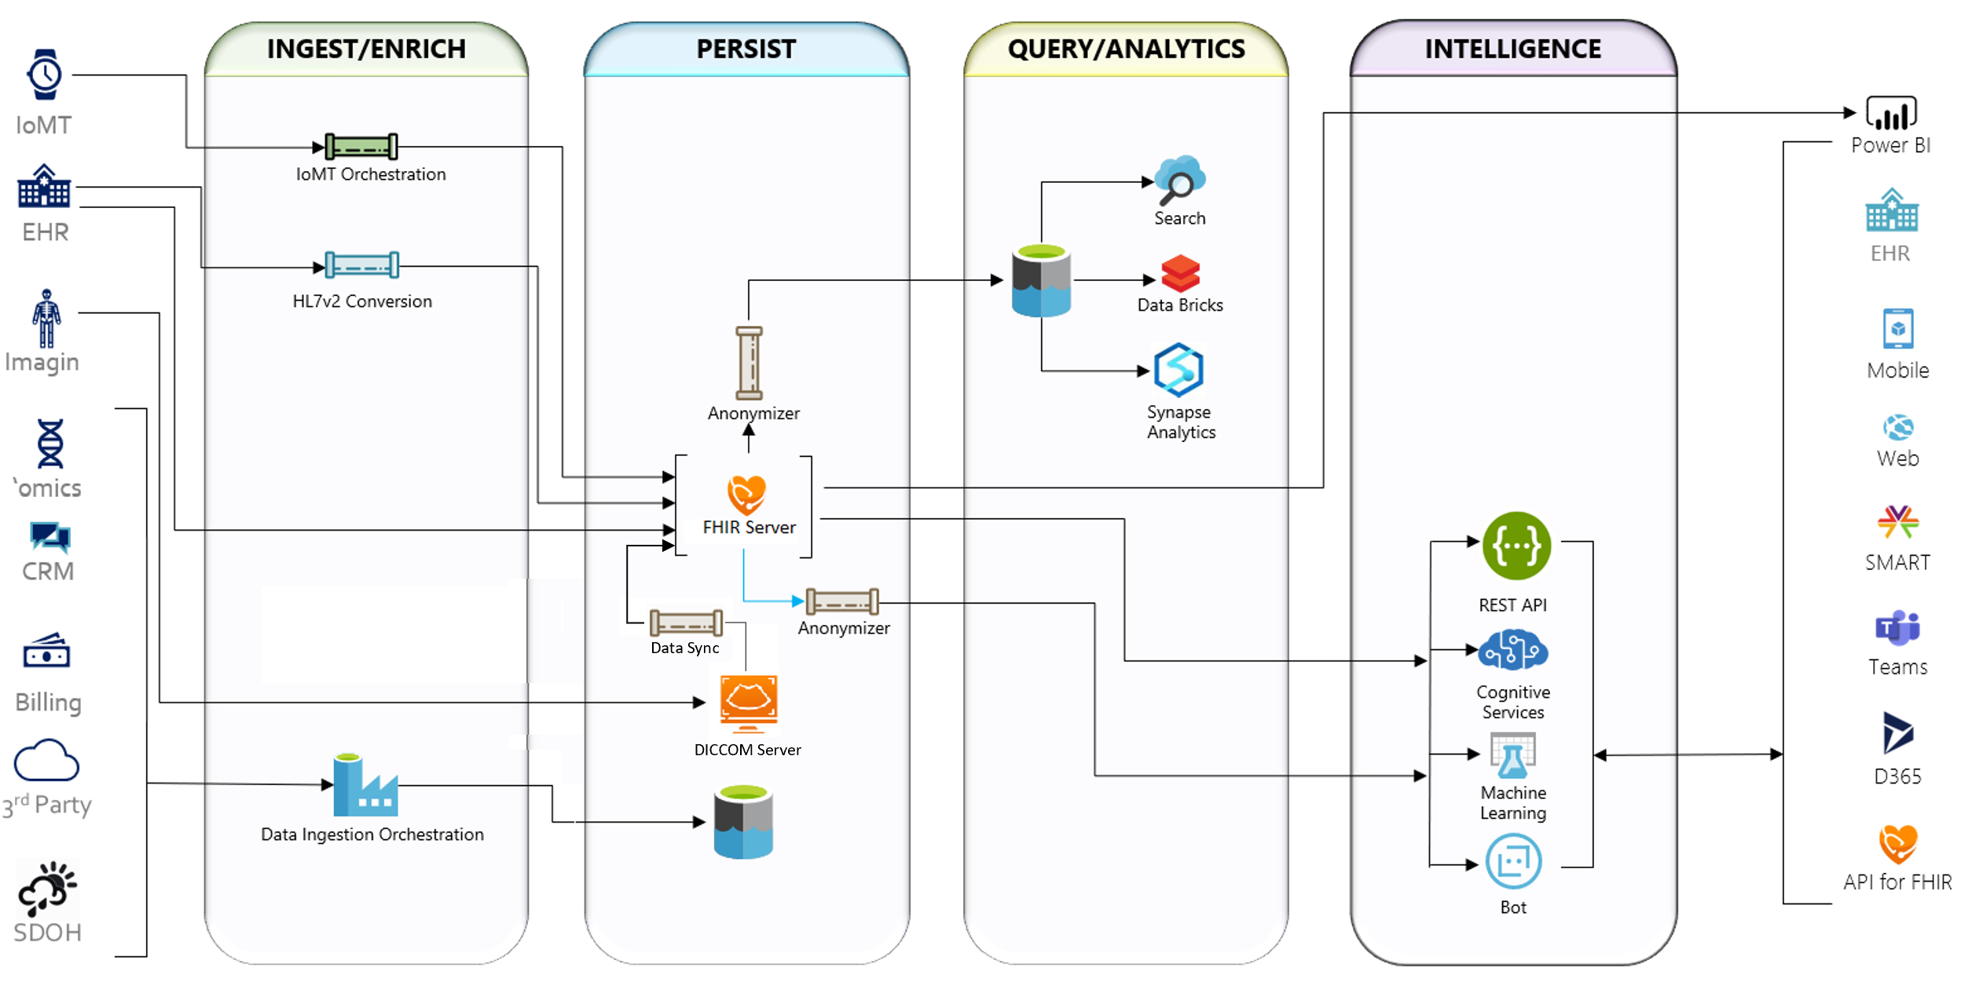
Microsoft Health Reference Architectures
Notes:
FhirDashboard URL: https://fhirsampdevdash.azurewebsites.net (.NET WebApp) or https://fhirsampdevjs.azurewebsites.net/ (JavaScript SPA app) User: fhirsampdev-admin@fhirserversamples.onmicrosoft.com Password: Fh1rD3m0!!

Slide 8
Challenge Zero Get your machines ready!
Install Windows Subsystem for Linux (Bash Shell)
Install the Azure CLI (in WSL if on Windows!)
Install PowerShell Cmdlets for Azure
Install Visual Studio Code
Install ARM Tools extension for VS Code
.NET Core 3.1
Java 1.8 JDK (for Synthea Patient Generator tool)
Node Module Extension for VS Code
App Service Extension for VS Code
Node.js Window Installer
Node.js and npm
Postman
Notes:
Modify this slide and add the pre-reqs specific to your hack here.
Each challenge slide should list the key goals for the challenge.
- **[.NET Core 3.1](https://dotnet.microsoft.com/download/dotnet-core/3.1)**
- **[Java 1.8 JDK](https://www.oracle.com/java/technologies/javase/javase-jdk8-downloads.html)** (needed to run Synthea Patient Generator tool)
- **[Node Module Extension for VS Code](https://code.visualstudio.com/docs/nodejs/extensions)**
- **[App Service extension for VS Code](https://marketplace.visualstudio.com/items?itemName=ms-azuretools.vscode-azureappservice)**
- **[Node.js Window Installer](https://nodejs.org/en/download/)**
- **[Node.js and npm](https://docs.npmjs.com/downloading-and-installing-node-js-and-npm)**
- **[Postman](https://www.getpostman.com)**

Slide 9
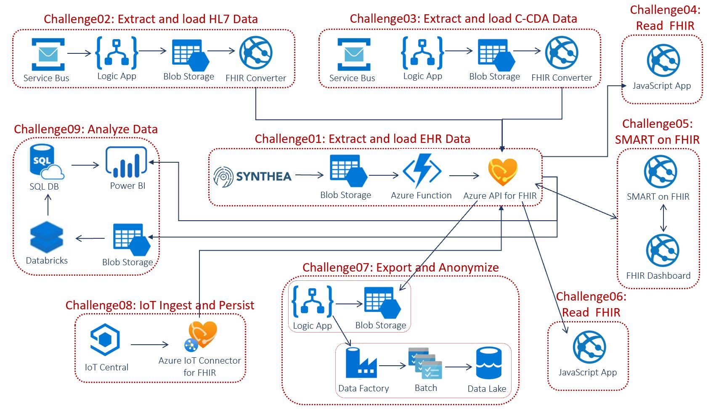
WTH – FHIR Powered Healthcare Challenges Overview of Microsoft Health References Architectures
Notes:
If you have a Mac… great! You’re already a step ahead.
If not, get your Windows box loaded up with all the tools that work well in the OSS world!

Slide 10

Challenge 1 Extract and load FHIR EHR data
Notes:
For each “mini-lecture”, have a topic title and/or sub-topic title.
Each mini-lecture should be no longer than 5-10 minutes in length.
Only deliver one lecture ahead of each challenge.
Do not attempt to present all of the lectures before students start hacking.

Slide 11

Challenge 1 Extract and Load FHIR EHR Data
Deploy Azure Health Data Services (AHDS) workspace
Instantiate FHIR service within the AHDS workspace
Deploy FHIR Bulk Loader pipeline to bulk load FHIR data
Generate simulated patient data in FHIR format and load them into FHIR Server
Notes:
Template for a lecture slide with bullets (if you need them).
Try to NOT use bullet lists in your presentation.
Diagrams, puppy pictures, etc are always better. ☺

Slide 12
Challenge #1 Extract and Load FHIR EHR Data
Key challenge goal #1
Challenge goal details/specifications
Takes inputs:
Location
A unique storage account name
Returns output:
storage account ID
Key challenge goal #2
Key challenge goal #3
Notes:
For each challenge, list out the key high-level goals.
If there are important specifications, list them here, or remind students to “read the student guide!”

Slide 13
Challenge 2 Extract & Load HL7v2 & C-CDA EHR Data
Notes:
For each “mini-lecture”, have a topic title and/or sub-topic title.
Each mini-lecture should be no longer than 5-10 minutes in length.
Only deliver one lecture ahead of each challenge.
Do not attempt to present all of the lectures before students start hacking.

Slide 14
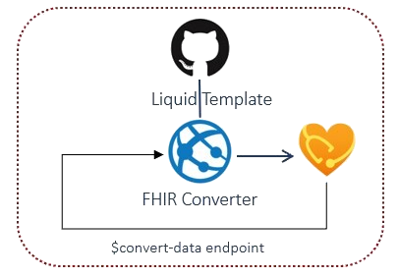
Title Segoe UI 54pt Slide Subtitle Segoe UI 32pt
Prepare API request for $convert-data operation in FHIR service
Configure Parameter Resource in the request body.
Call $convert-data endpoint via Postman to convert legacy health data
Test send sample HL7v2 and sample C-CDA requests in the request body payload and make the appropriate $convert-data API calls to receive FHIR Bundle response
Notes:
Template for a lecture slide with bullets (if you need them).
Try to NOT use bullet lists in your presentation.
Diagrams, puppy pictures, etc are always better. ☺

Slide 15
Challenge #2 <Insert Challenge #2 Title here>
Key challenge goal #1
Challenge goal details/specifications
Takes inputs:
Location
A unique storage account name
Returns output:
storage account ID
Key challenge goal #2
Key challenge goal #3
Notes:
For each challenge, list out the key high-level goals.
If there are important specifications, list them here, or remind students to “read the student guide!”

Slide 16
Challenge 3 Search FHIR EHR Data
Notes:
For each “mini-lecture”, have a topic title and/or sub-topic title.
Each mini-lecture should be no longer than 5-10 minutes in length.
Only deliver one lecture ahead of each challenge.
Do not attempt to present all of the lectures before students start hacking.

Slide 17
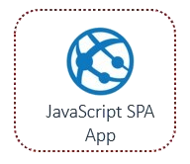
Challenge 3 Search FHIR EHR Data
Create a new JavaScript SPA app
Integrate and configure the Microsoft Authentication Library (MSAL) with your JavaScript SPA app to fetch data from protected FHIR web API.
Create a patient lookup by Given or Family name in JavaScript SPA app.
Build and run JavaScript SPA app (local and Azure)
Register Patient Search app website URI in App Registration (local and Azure)
Test Patient Lookup in Patient Search app website
Notes:
Template for a lecture slide with bullets (if you need them).
Try to NOT use bullet lists in your presentation.
Diagrams, puppy pictures, etc are always better. ☺

Slide 18
Challenge #X <Insert Challenge #X Title here>
Key challenge goal #1
Challenge goal details/specifications
Takes inputs:
Location
A unique storage account name
Returns output:
storage account ID
Key challenge goal #2
Key challenge goal #3
Notes:
For each challenge, list out the key high-level goals.
If there are important specifications, list them here, or remind students to “read the student guide!”

Slide 19
Challenge 4 Explore and Analyze FHIR EHR Data
Notes:
For each “mini-lecture”, have a topic title and/or sub-topic title.
Each mini-lecture should be no longer than 5-10 minutes in length.
Only deliver one lecture ahead of each challenge.
Do not attempt to present all of the lectures before students start hacking.

Slide 20
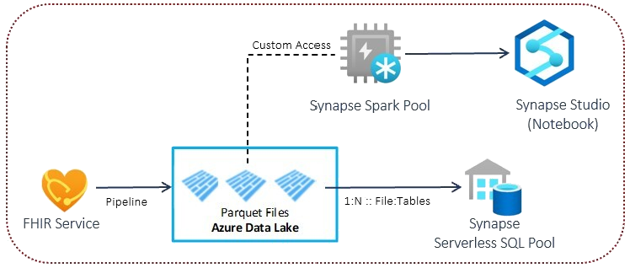
Challenge 4 Explore and Analyze FHIR EHR Data
Deploy FHIR Analytics pipeline
Create external tables and views in Synapse Serverless SQL Pool
Explore flatten FHIR dataset using Synapse Studio
Notes:
Template for a lecture slide with bullets (if you need them).
Try to NOT use bullet lists in your presentation.
Diagrams, puppy pictures, etc are always better. ☺

Slide 21
Challenge 5 Export and Anonymize FHIR EHR Data
Notes:
For each “mini-lecture”, have a topic title and/or sub-topic title.
Each mini-lecture should be no longer than 5-10 minutes in length.
Only deliver one lecture ahead of each challenge.
Do not attempt to present all of the lectures before students start hacking.

Slide 22
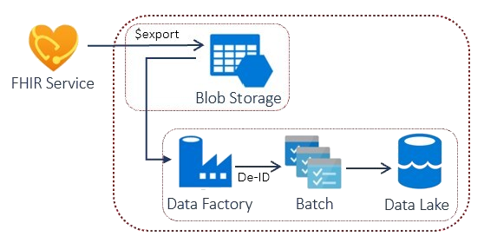
Challenge 5 Export and Anonymize FHIR EHR Data
Bulk Export FHIR data from FHIR Server into Blob Storage using Logic App
Use Data Factory to call Azure Batch to Anonymize FHIR data, configure as needed
Store the Anonymized FHIR data into Azure Data Lake Gen2 for post-processing
Notes:
Template for a lecture slide with bullets (if you need them).
Try to NOT use bullet lists in your presentation.
Diagrams, puppy pictures, etc are always better. ☺

Slide 23
Challenge 6 Ingest & Persist IoT Medical Device Data
Notes:
For each “mini-lecture”, have a topic title and/or sub-topic title.
Each mini-lecture should be no longer than 5-10 minutes in length.
Only deliver one lecture ahead of each challenge.
Do not attempt to present all of the lectures before students start hacking.

Slide 24
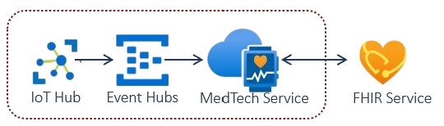
Challenge 6 Ingest and Persist IoT Medical Device Data
Deploy MedTech Data Flow pipeline
Transform IoT device data using IoT Data Mapper tool
Ingest test IoT medical device data in FHIR as Observations via EventHub API request in Postman
Notes:
Template for a lecture slide with bullets (if you need them).
Try to NOT use bullet lists in your presentation.
Diagrams, puppy pictures, etc are always better. ☺

Slide 25
Challenge 7 Load DICOM Imaging Data
Notes:
For each “mini-lecture”, have a topic title and/or sub-topic title.
Each mini-lecture should be no longer than 5-10 minutes in length.
Only deliver one lecture ahead of each challenge.
Do not attempt to present all of the lectures before students start hacking.

Slide 26
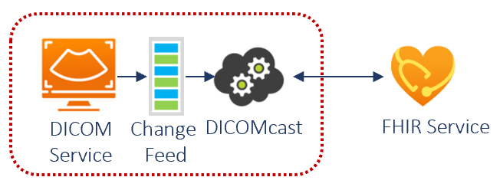
Challenge 6 Load DICOM Imaging Data
Deploy DICOM service in ADHS workspace
Deploy DICOMcast synchronization pipeline
Load DICOM imaging data in DICOM service and store imaging metadata in FHIR service
Notes:
Template for a lecture slide with bullets (if you need them).
Try to NOT use bullet lists in your presentation.
Diagrams, puppy pictures, etc are always better. ☺

Slide 27
Thank You for Attending! https://aka.ms/wth
Notes:
Thank students for attending and share the link to the What The Hack website with them.

